Slide 1




CONDITIONAL
SENTENCES

Slide 2






Agenda
  Conditional Type 1
  Conditional Type 2
  Conditional Type 3
  Exercise 1
  Exercise 2
  Exercise 3

Slide 3


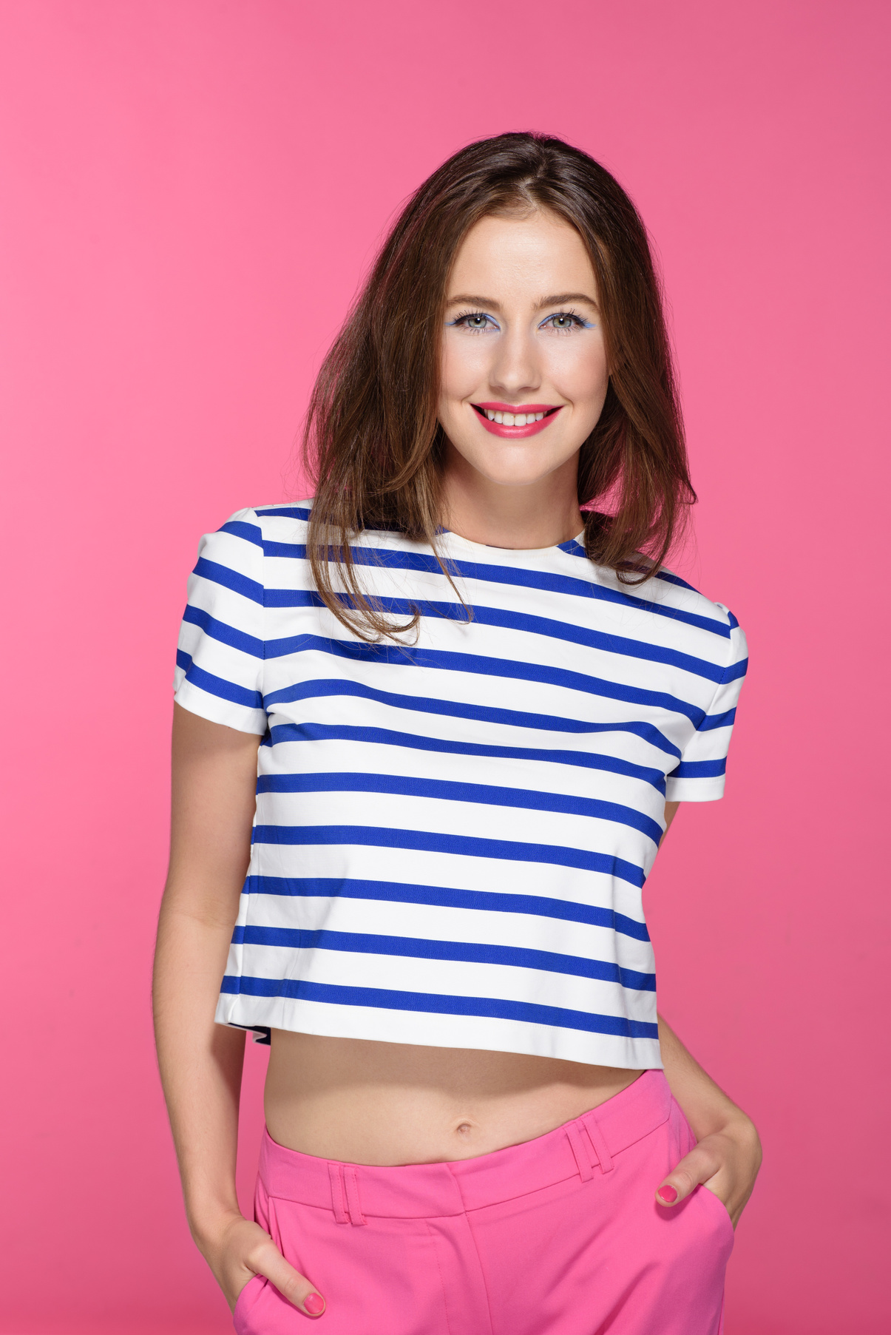
Conditional Sentence Type 1
  NOW, UNTRUE, STILL POSSIBLE
  Simple present + present modals (will, can)
  For example: If we have more time, we can still finish the job.

Slide 4
Conditional Sentence Type 2
  UNTRUE, IMPOSSIBLE
  Simple past + past modals (could, would)
  For example: If we had more time, we could still finish the job.

Slide 5
Conditional Sentence Type 3
  PAST, UNTRUE
  Past perfect + could/would/should have + past participle (verb 3)
  For example: If we had had more time, we could have finished the job.
  OR We could have finished the job if we had had more time.

Slide 6


EXERCISE 1
  COMPLETE THE CONDITIONAL SENTENCES TYPE I.
  If you (go) ______ out with your friends tonight, I (watch) ______ the football match on TV.
  I (earn) ______ a lot of money if I (get) ______ that job.
  If she (hurry / not) ______, we (miss) ______ the bus.
Complete the sentences.
  COMPLETE THE CONDITIONAL SENTENCES TYPE 2.
  If he (try) ______ harder, he (reach) ______ his goals.
  I (buy) ______ these shoes if they (fit) ______.
  It (surprise / not) ______ me if he (know / not) ______ the answer.

Slide 7
EXERCISE 1
  COMPLETE THE CONDITIONAL SENTENCES TYPE 3.
  If we (listen) ______ to the radio, we (hear) ______ the news.
  If you (switch) ______ on the lights, you (fall / not) ______ over the chair.
  She (come) ______ to our party if she (be / not) ______ on holiday.
Complete the sentences.

Slide 8
EXERCISE 2
COMPLETE THE CONDITIONAL SENTENCES TYPE 1, 2, OR 3.
Complete the sentences.
  If I (be) __________________ stronger, I'd help you carry the piano.
  If we'd seen you, we (stop) __________________.
  If we (meet) __________________ him tomorrow, we'll say hello.
  He would have repaired the car himself if he (has)__________________ the tools.
  If you drop the vase, it (break) __________________.

Slide 9
EXERCISE 2
COMPLETE THE CONDITIONAL SENTENCES TYPE 1, 2, OR 3.
Complete the sentences.
  If I hadn't studied, I (pass, not) __________________ the exam.
  I wouldn't go to school by bus if I (have) __________________ a driving licence.
  If she (see, not) __________________ him every day, she'd be lovesick.
  I (travel, not) __________________ to London if I don't get a cheap flight.
  We'd be stupid if we (tell) __________________ him about our secret.

Slide 10


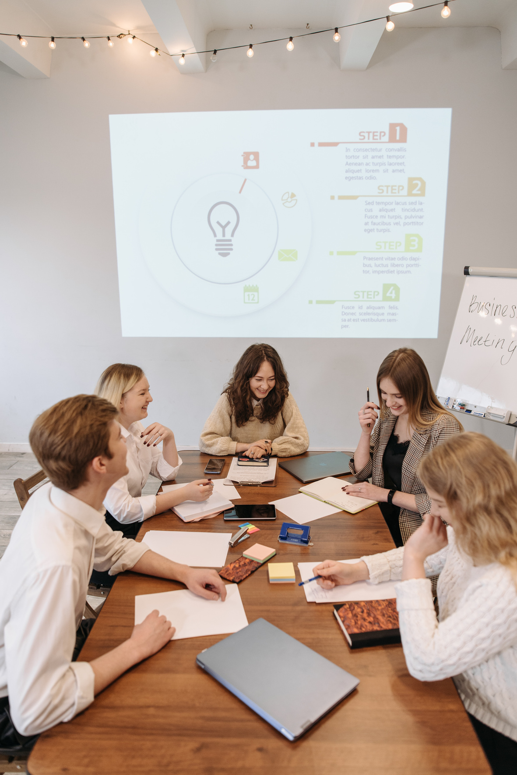

EXERCISE 3
READING TEXT
Once upon a time, there was a young girl named Sarah. She was an avid reader and loved nothing more than getting lost in the pages of a book. She dreamed of becoming a writer one day, but she didn't think it was possible. She often thought to herself, "If only I had the time to writea book, then I could become a writer."
But one day, Sarah's teacher assigned a writing project for the class and it was then when she realized that if she set aside a little bit of time every day to work on her writing, she could turn her dream into reality. So she began to write every day after school for a short period of time. She wrote about her adventures, her friends, and her family.
And as she wrote, her stories started to take shape, and before she knew it, she had written an entire novel. She showed it to her teacher, who was impressed with her work and encouraged her to submit it to a publisher. If she hadn't had that teacher that gave her an assignment, she would have never started writing.
Find the conditional sentences.

Slide 11
EXERCISE 3
READING TEXT
After a few rejections, one publisher finally accepted her book, and soon it was being read by people all over the world. Sarah realized that the key to achieving her dreams was persistence and dedication. If she had given up after the first rejection, she would have never become a published author. But because she kept going, she was able to make her dream a reality.
From that day on she wrote many books, and became a well-known author, who now has her own readers and fans. If she had not believed in herself and her work, she would never have reachedthat level of success.
But also, if she hadn't spent her free time reading, she wouldn't have developed the passion for writing. And if the publisher had not taken a chance on an unknown author like her, her book would have never been published.
Now, if she is invited to participate in a book fair, she will certainly go. When she receives a good review, she will be very happy. If she sells out all her books, she will consider writing a new one. And if she wins an award, she will be over the moon!
Find the conditional sentences.

Slide 12
THANK
YOU!

