Slide 1


GIVING
INSTRUCTION
MEETING 12

Slide 2

CONTENT
01
INSTRUCTION VOCABULARY
02
ASKING INSTRUCTION
03
GIVING INSTRUCTION
04
DIALOGUE
05
ASSIGNMENT

Slide 3
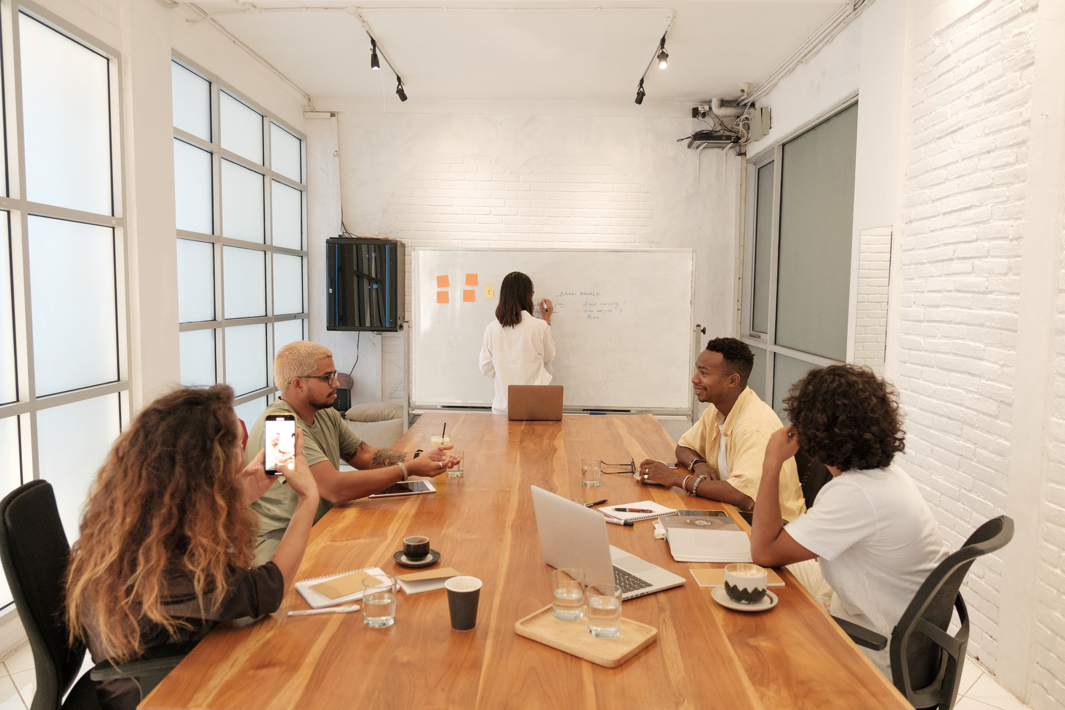

Instruction vocabularies:
First, First of all
Finally
Second, secondly
The last point
Third, thirdly
Further more
Before that
In addition
After that
Next step
Then
Finishing step/ last touch

Slide 4


Asking instruction
How do I _____?
Can you show me how to ____?
Do you know how to ___?
What is the first step to ____?
What is the best way to ___?

Slide 5
Giving Instruction
Starting out:
First, you ___
Then, you ____
Next, you ___
Lastly, you ___
The first thing you do is ___
Before you begin, (you should___)
The best place to begin is ___
I would start by ___
Continuing:
Finishing:
After that ___
The next step is to ___
The next thing you do is ___
Once you’ve done that, then ___
When you finish that, then ___
The last step is ___
The last thing you do is ___
In the end ___
When you’ve finished, ___
When you’ve completed all the steps, ___

Slide 6
Dialogue
A:
Good morning!
Good morning!
B:
A:
Do you know what are we going to study? Well, today I will show you how to operate about CorelDraw program. Firstly, turn on your computer.
B:
Yes!
A:
Secondly, click the CorelDraw icon located at the main desktop.
B:
Alright!
A:
Then, draw an icon from the shape tool and be creative from it!
B:
Alright!

Slide 7
Dialogue
Linda :
You know, I’m thinking about designing a website for our company.
Ruben :
Do you know how to design a website? Could you please share it to me because I have no idea.
Linda :
That doesn’t matter. We can learn it. Let me read the instruction to make a website. First of all, login to home page. Click on the link in the navigation panel. Then, click the ‘Sign Up Now’. Now create your Website.
Ruben :
Wow. That’s easy. I think we can do it.

Slide 8



ASSIGNMENT
Work in groups of 2-3 and make a dialogue on Range of Motion based on the correct SOP. Submit your dialogue to our Google Drive.
Deadline submission:
Tuesday, 17 Dec 2024 at 18.00

Slide 9

THANK YOU

